Slide 1
Software Quality Assurance
Group Activity
Dr. Seemab Latif
Lecture No. 10
1st December, 2010

Slide 2
Introduction
Form a group of 5 students.
A code will be provided to you.
You have to perform a Formal Code Review process
Decide among yourselves the roles of the code review
Follow the steps care fully
By the end of the process provide me the document which list down the minutes, follow up work (CR) and who is responsible to validate the CR.
Keep in mind you have only 35 mins to do the code review

Slide 3
Roles in Code Review
During an inspection the following roles are used.
Author: The person who created the work product being inspected.
Moderator: This is the leader of the inspection. The moderator plans the inspection and coordinates it.
Reader: The person reading through the documents, one item at a time. The other inspectors then point out defects.
Recorder/Scribe: The person that documents the defects that are found during the inspection.
Inspector: The person that examines the work product to identify possible defects.

Slide 4
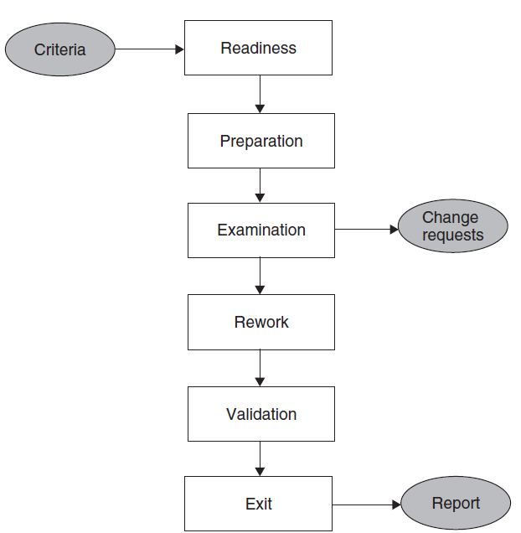
Code Review Process

Slide 5
Code Review Process
Step 1: Readiness: The author of the unit ensures that the unit under test is ready for review. A unit is said to be ready if it satisfies the following criteria:
Completeness: code relating to the unit to be reviewed must be available,
Minimal Functionality: code must compile and link.
Readability: highly readable code.
Complexity:The code to be reviewed must be of sufficient complexity (no. of conditional statements, input/output data elements, real-time processing of the code, and the no. of other units with which the code communicates).
Requirements and Design Documents: latest approved version of the low-level design specification must be available.

Slide 6
Code Review Process
Step 2: Preparation: Before the meeting, each inspector carefully reviews the work package. It is expected that the inspectors read the code and understand its organization and operation before the review meeting. Each inspector develops the following:
List of Questions: An inspector prepares a list of questions to be asked, if needed, of the author to clarify issues arising from his or her reading.
Potential Change Request: An inspector may make a formal request to make a change.
Suggested Improvement Opportunities: The inspectors may suggest how to fix the problems, if there are any, in the code under review.

Slide 7
Code Review Checklist
Does the code do what has been specified in the design specification?
Does the procedure used in the module solve the problem correctly?
Does a software module duplicate another existing module which could be reused?
If library modules are being used, are the right libraries and the right versions of the libraries being used?
Does each module have a single entry point and a single exit point? Multiple exit and entry point programs are harder to test.
Is the cyclomatic complexity of the module more than 10? If yes, then it is extremely difficult to adequately test the module.
Can each atomic function be reviewed and understood in 10–15 minutes? If not, it is considered to be too complex.
Have naming conventions been followed for all identifiers, such as pointers, indices, variables, arrays, and constants? It is important to adhere to coding standards to ease the introduction of a new contributor (programmer) to the development of a system.
Has the code been adequately commented upon?
Have all the variables and constants been correctly initialized? Have correct types and scopes been checked?
Are the global or shared variables, if there are any, carefully controlled?
Are there data values hard coded in the program? Rather, these should be declared as variables.
Are the pointers being used correctly?
Are the dynamically acquired memory blocks de-allocated after use?
Does the module terminate abnormally? Will the module eventually terminate?
Is there a possibility of an infinite loop, a loop that never executes, or a loop with a premature exit?
Have all the files been opened for use and closed at termination?
Are there computations using variables with inconsistent data types? Is overflow or underflow a possibility?
Are error codes and condition messages produced by accessing a common table of messages? Each error code should have a meaning, and all of the meanings should be available at one place in a table rather than scattered all over the program code.
Is the code portable? The source code is likely to execute on multiple processor architectures and on different operating systems over its lifetime. It must be implemented in a manner that does not preclude this kind of a variety of execution environments.
Is the code efficient? In general, clarity, readability, or correctness should not be sacrificed for efficiency. Code review is intended to detect implementation choices that have adverse effects on system performance.

Slide 8
Code Review Process
Step 3: Examination :The examination process consists of the following activities:
The author makes a presentation of the procedural logic used in the code, the paths denoting major computations, and the dependency of the unit under review on other units.
The reader reads the code line by line. The inspector may raise questions if the code is seen to have defects.
The recorder documents the change requests and the suggestions for fixing the problems, if there are any.
A Change Request (CR) includes the following details:
Give a brief description of the issue or action item.
Assign a priority level (major or minor) to a CR.
Assign a person to follow up the issue.
Set a deadline for addressing a CR.

Slide 9
Code Review Process
Step 4: Rework: At the end of the meeting, the recorder produces a summary of the meeting that includes the following information:
A list of all the CRs, the dates by which those will be fixed, and the names of the persons responsible for validating the CRs
A list of improvement opportunities
The minutes of the meeting (optional)
A copy of the report is distributed to all the members of the review group. After the meeting, the author works on the CRs to fix the problems.
The author documents the improvements made to the code in the CRs. The author makes an attempt to address the issues within the agreed-upon time frame using the prevailing coding conventions.

Slide 10
Code Review Process
Step 5: Validation: The CRs are independently validated by the moderator or another person designated for this purpose.
The validation process involves checking the modified code as documented in the CRs and ensuring that the suggested improvements have been implemented correctly.
The revised and final version of the outcome of the review meeting is distributed to all the group members.

